Slide 1
Project lane Segmentation
Milan Joshi

Slide 2
Project - Lane Segmentation for Self-Driving Systems

Slide 3
What we will be covering in this module?
Introduction is Image Segmentation
How to solve Image Segmentation problems?
Approaches for Image Segmentation
Use Traditional Methods
Leverage Deep Learning
Understanding Deep Learning Architectures for Image Segmentation
Project on Lane Segmentation for Self Driving Cars
What’s Next?

Slide 4
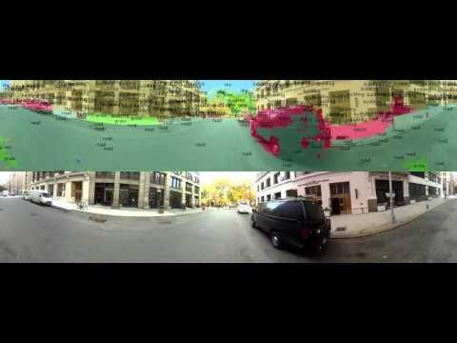
Overview of Business Problem

Slide 5
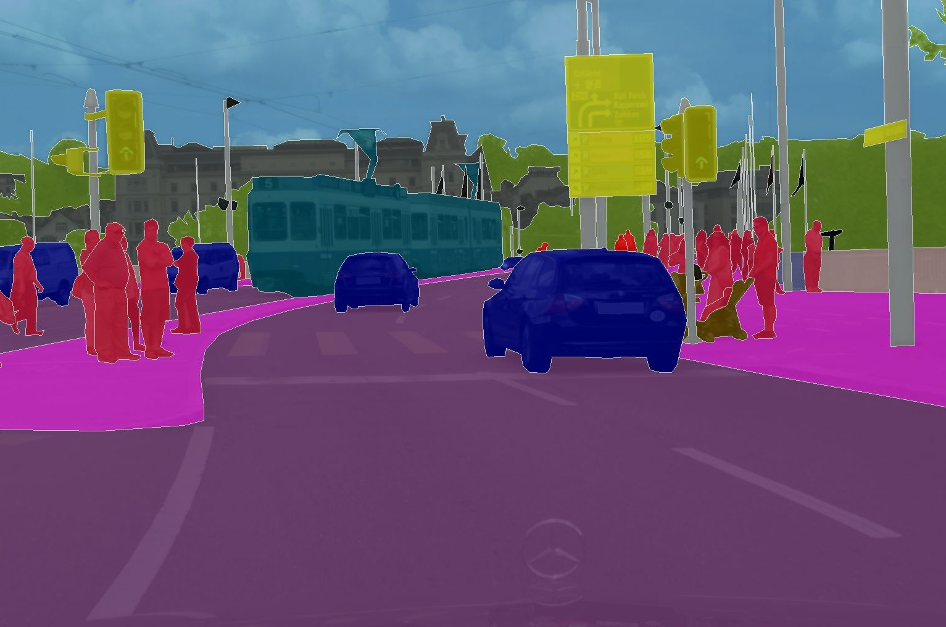
Overview of Data Science Problem
Source: Marius Cordts et al: “The Cityscapes Dataset for Semantic Urban Scene Understanding”, 2016

Slide 6
Lane Segmentation problem
Source: Marius Cordts et al: “The Cityscapes Dataset for Semantic Urban Scene Understanding”, 2016

Slide 7
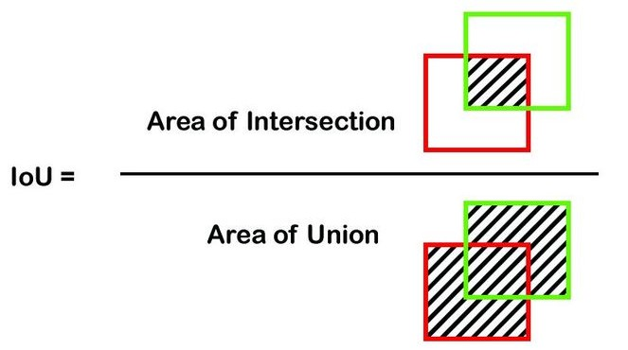
Evaluation Metrics for Image Segmentation
IoU
Pixelwise Accuracy

Slide 8
Evaluation Metrics for Image Segmentation
IoU
Number of correct predictions
Accuracy =
Pixelwise Accuracy
Total Number of values

Slide 9
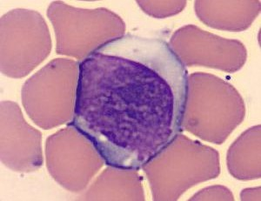

Approach to solve Lane Segmentation
Advanced Deep Learning

Slide 10

Loss Functions to Train DL Models
Binary Cross Entropy
Dice Loss

Slide 11
Loss Functions to Train DL Models
Binary Cross Entropy
2 x
Dice Score
Dice Score =
Total Area

Slide 12
Project - Lane Segmentation for Self-Driving Systems

Slide 13
Steps to Solve Lane Segmentation - FCN model
Data Loading and Preprocessing
Load the Data
Deﬁne custom dataset
Data Exploration
Lane Segmentation using FCN
Deﬁne model architecture
Train the model
Calculate IoU score

Slide 14
Code Walkthrough of Lane Segmentation using FCN

Slide 15
Project - Lane Segmentation for Self-Driving Systems

Slide 16
Steps to Solve Lane Segmentation - DeepLabv3 model
Data Loading and Preprocessing
Load the Data
Deﬁne custom dataset
Data Exploration
Lane Segmentation using DeepLabv3
Deﬁne model architecture
Train the model
Calculate IoU score

Slide 17
Code Walkthrough of
Lane Segmentation using DeepLabv3

Slide 18
Project - Lane Segmentation for Self-Driving Systems

Slide 19
Steps to Solve Lane Segmentation - U-Net model
Data Loading and Preprocessing
Load the Data
Deﬁne custom dataset
Data Exploration
Lane Segmentation using Simple U-Net
Deﬁne model architecture
Train the model
Calculate IoU score

Slide 20
Code Walkthrough of
Lane Segmentation using Simple U-Net model

Slide 21
Project - Lane Segmentation for Self-Driving Systems

Slide 22
Steps to Solve Lane Segmentation - U-Net with Best Practices
Data Loading and Preprocessing
Load the Data
Deﬁne custom dataset
Data Exploration
Lane Segmentation using U-Net with Best Practices
Deﬁne validation and test dataloader
Deﬁne model architecture
Train the model
Calculate IoU score
Inference on Test Dataset

Slide 23
Code Walkthrough of U-Net with Best Practices

